Slide 1

CHASEUP SHOPPING MALL MANAGEMENT PROJECT
SUBMITTED TO HONOURABLE SIR SAIF- UL-REHMAN KHAN

Slide 2

INTRODUCTION OF GROUP MEMBERES
MUHAMMAD MUZAMMIL # 24

Slide 3



A LOT OF THANKS SIR SAIF-UL REHMAN KHAN .

Slide 4
PROJECT INTRODUCTION
In 1785, the first purposely-built shopping mall was created.
It was not until 1916 that a shopping mall.
We consider them today was built in the United States.
Our main purpose is to make the shopping easier .
In our project you have to select the product.
You simply pay your bill by credit card or by using counter payment that is an older method.

Slide 5
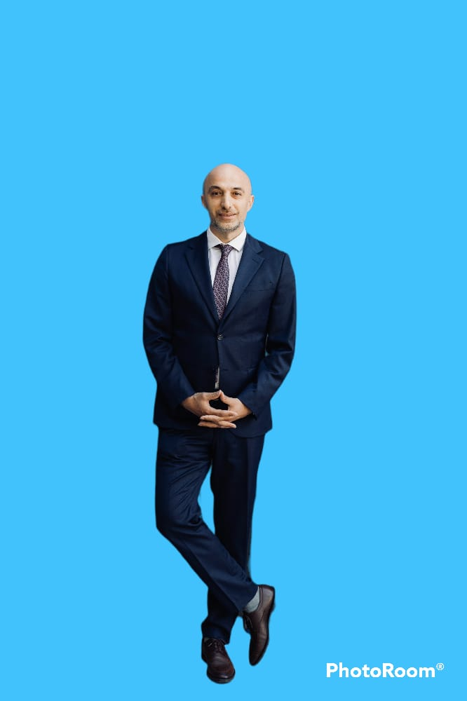
Over view of our project
BANK
CHASE UP MARKETING
outfitters
PUMA
ADIDAS
ATM
ZARA
NEXT
DIOR

Slide 6
OUTFITTERS
SELECT THE PRODUCTS YOU WANT TO BUY

Slide 7
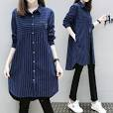
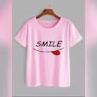
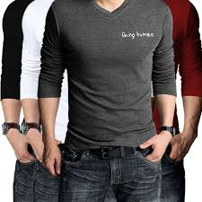
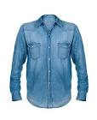
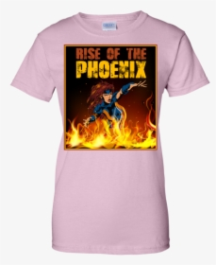
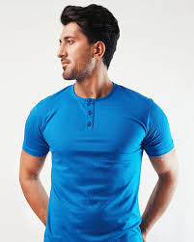
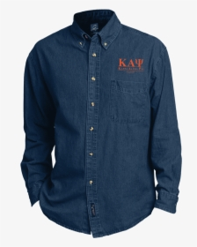
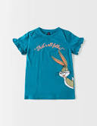
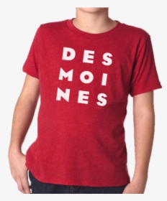
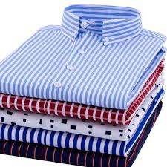
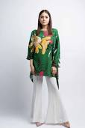
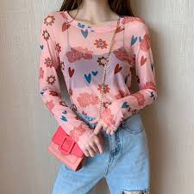
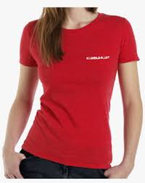
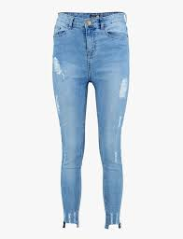
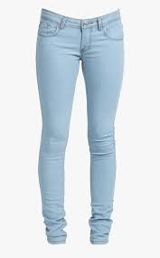
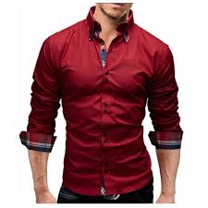
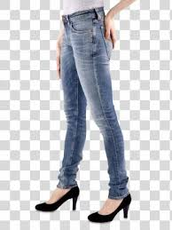

Slide 8
SELECTED PRODUCTS
JEANS XS 67
SHIRT SX 91
JEANS SL 69
PENT MX 65
RS:1800
RS:2500
RS:2600
RS:3000

Slide 9
Payment
COUNTER
CREDIT CARD

Slide 10

Account name
Account pin

Slide 11
PROBLEMS
The problem that we resolved in our project is that the shopping without this method is difficult.
It is not possible to see all the varaties of the products in the market.
We make it possibIe that a customer see all the products.
We make it possible that all the products are arranged in sequence.
We improve payment and security method.
We replace the counter payment by the credit card payment.
During payment the user name and the pin is also necessary.

Slide 12
MOTIVATION
The thing that attract the most is that the shopping system in the world is not satisfactory.
The payment method is not secure.
Our main target in this project is to improve the security payment system.
We are motivated from this factor that we have to improve the security system.
Even the user can’t able to see all the products this thing also motivated us.
Customer should see all the products before selecting for him.

Slide 13
CONCLUSION
Technology has made significant progress.
Over the years to provide consumers a better online shopping experience.
Before online shopping there was only shopping in store.
The world has got more technology.
shopping online has become more popular.
You can make the shopping creative as you get used to it.

Slide 14


